Slide 1


Airplane Crash Analysis

Slide 2



Introduction
Airplane crash incidents are complex events with multiple factors.
Understanding the causes and contributing factors is crucial for aviation safety. This presentation will decode the various elements involved in airplane crashes.

Slide 3




Types of Incidents
Airplane crash incidents can be classiﬁed into mechanical failures, pilot errors, weather-related, and external factors. Each type presents unique challenges and requires speciﬁc investigation techniques.

Slide 4









Investigation Process
The investigation process involves gathering evidence from ﬂight data recorders, witness accounts, and forensic analysis. It requires collaboration between aviation experts, engineers, and law
enforcement.

Slide 5
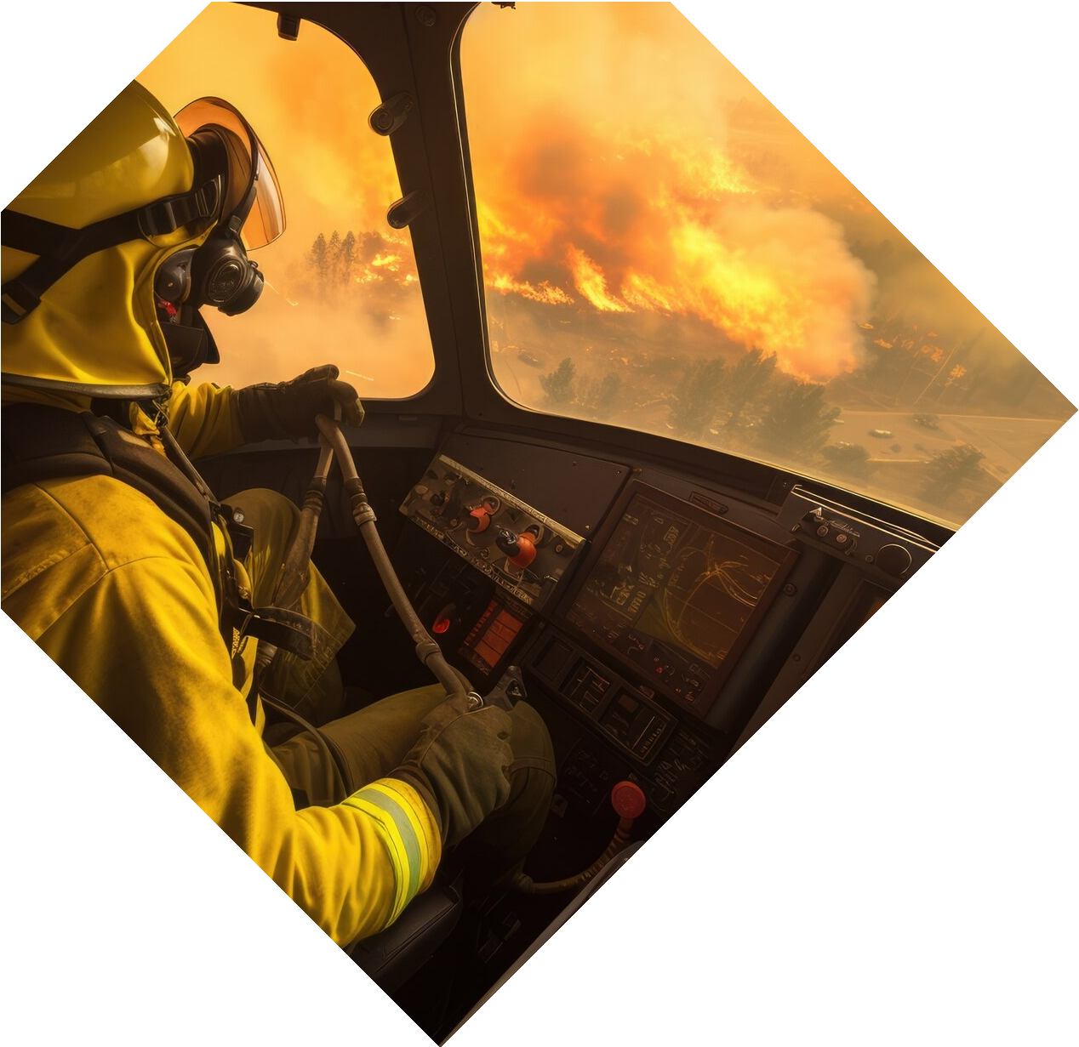






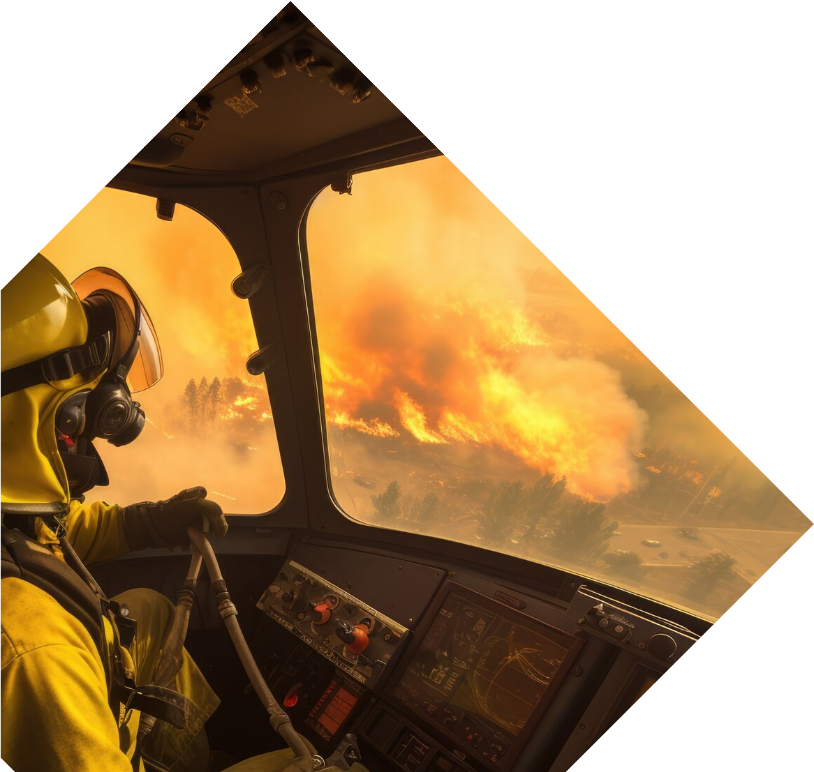
Human Factors
Human factors such as pilot fatigue, training, and communication play a signiﬁcant role in airplane crash incidents. Understanding these factors is essential for improving pilot performance and safety protocols.

Slide 6


Conclusion
Decoding airplane crash incidents is crucial for preventing future tragedies. By analyzing the various elements involved, we can improve aviation safety and strive for zero accidents.

Slide 7
Thanks

